Slide 1
Reusing Classes
Chpt 8 & 9
Inheritance and Composition

Slide 2
Composition
Composition = When you compose a new class using other class objects
class Engine {}
class Wheel{}
class Car{
  Engine e = new Engine();
  Wheel []wheels = new Wheel[4];
  public Car(){
    for(int i=0;i<wheels.length;i++)
      wheels[i] = new Wheel();
    }
  }

Slide 3
Inheritance
All classes inherit from the class Object explicitly or implicitly
To inherit from a class you use the keyword “extends” as in “class B extends A”
All members of the class you extend are inherited, including private members
Notes:
September 8 /08

Slide 4
What is inherited
public class Animal{
private int x;
public void draw(){}
}
public class Dog extends Animal{
//implicitly inherited “int x” but no direct access
//implicitly contains method “draw()”
}

Slide 5
Overriding methods
If a method that is inherited from a class has its behaviour altered, it is known as overriding the method
Image a class Animal that has a method move(). If fish extends Animal then it inherits method move(). If move() was defined for land animals, it stands to reason that you’d want to alter the behaviour of the move() method inherited

Slide 6
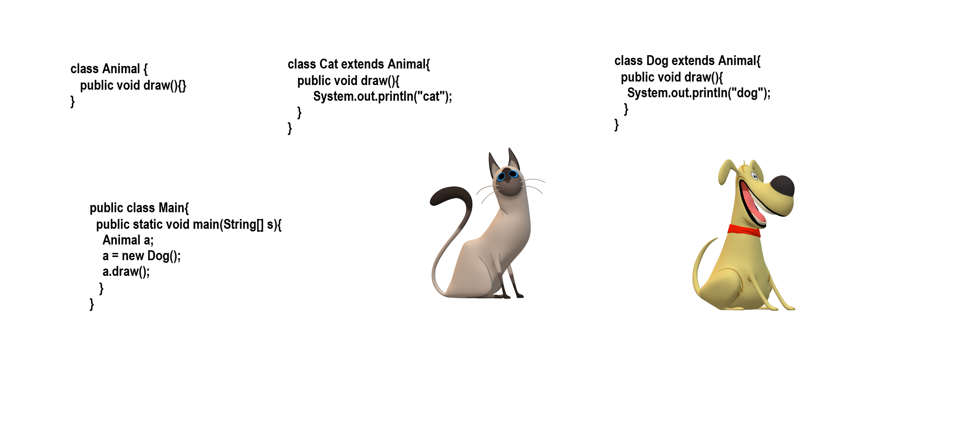
Overriding draw()
Notes:
If you think of the Animal a; as a remote control it contains one button called “draw()”. It is aimed at a Dog object and when the button is pressed it draws a dog as expected.

